Slide 1


Chapter 2: Relational Model
Database System Concepts, 5th Ed.
©Silberschatz, Korth and Sudarshan
See www.db-book.com for conditions on re-use

Slide 2
Chapter 2: Relational Model
■
Structure of Relational Databases
■
Fundamental Relational-Algebra-Operations
■
Additional Relational-Algebra-Operations
■
Extended Relational-Algebra-Operations
■
Null Values
■
Modification of the Database
Database System Concepts - 5th Edition, June 15, 2005
2.<number>
©Silberschatz, Korth and Sudarshan

Slide 3
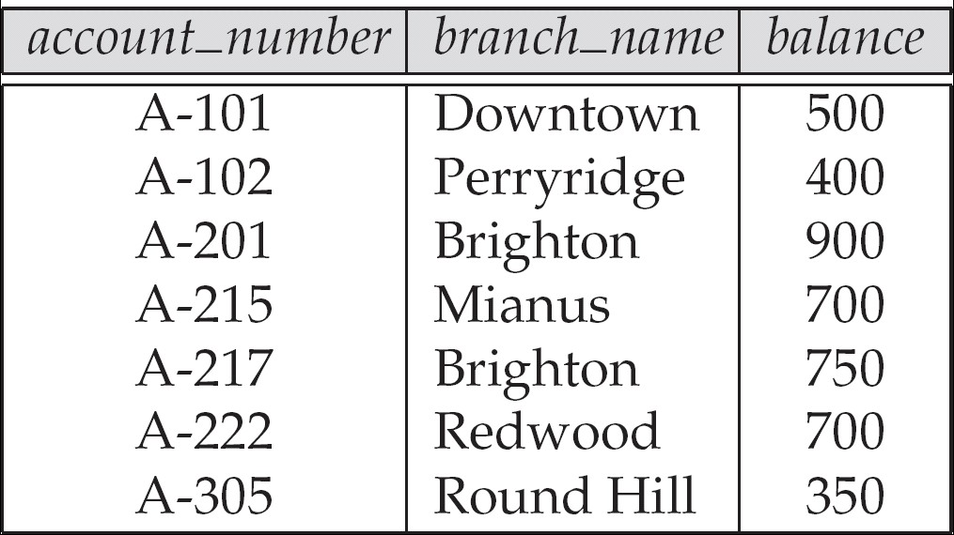
Example of a Relation
Database System Concepts - 5th Edition, June 15, 2005
2.<number>
©Silberschatz, Korth and Sudarshan

Slide 4
Basic Structure
Formally, given sets D₁, D₂, …. D_{n} a relation r is a subset of
D₁ x D₂ x … x D_{n}
Thus, a relation is a set of n-tuples (a₁, a₂, …, a_{n}) where each a_{i} ∈ D_{i}
■
Example: If
●
customer_name = {Jones, Smith, Curry, Lindsay, …}
/* Set of all customer names */
●
customer_street = {Main, North, Park, …} /* set of all street names*/
customer_city = {Harrison, Rye, Pittsfield, …} /* set of all city names */
●
Then r = { (Jones, Main, Harrison),
(Smith, North, Rye), (Curry, North, Rye), (Lindsay, Park, Pittsfield) }
is a relation over
customer_name x customer_street x customer_city
Database System Concepts - 5th Edition, June 15, 2005
2.<number>
©Silberschatz, Korth and Sudarshan

Slide 5
Attribute Types
■
Each attribute of a relation has a name
■
The set of allowed values for each attribute is called the domain of the
attribute
■
Attribute values are (normally) required to be atomic; that is, indivisible
●
E.g. the value of an attribute can be an account number,
but cannot be a set of account numbers
■
Domain is said to be atomic if all its members are atomic
■
The special value null is a member of every domain
■
The null value causes complications in the definition of many operations
●
We shall ignore the effect of null values in our main presentation and
consider their effect later
Database System Concepts - 5th Edition, June 15, 2005
2.<number>
©Silberschatz, Korth and Sudarshan

Slide 6
Relation Schema
A₁, A₂, …, A_{n} are attributes
R = (A₁, A₂, …, A_{n} ) is a relation schema
Example:
Customer_schema = (customer_name, customer_street, customer_city)
■
r(R) denotes a relation r on the relation schema R
Example:
customer (Customer_schema)
Database System Concepts - 5th Edition, June 15, 2005
2.<number>
©Silberschatz, Korth and Sudarshan

Slide 7
Relation Instance
■
The current values (relation instance) of a relation are specified by a
table
■
An element t of r is a tuple, represented by a row in a table
attributes (or columns)
customer_name customer_street
customer_city
Jones Smith Curry Lindsay
Main North North Park
Harrison Rye Rye Pittsfield
tuples
(or rows)
customer
Database System Concepts - 5th Edition, June 15, 2005
2.<number>
©Silberschatz, Korth and Sudarshan

Slide 8
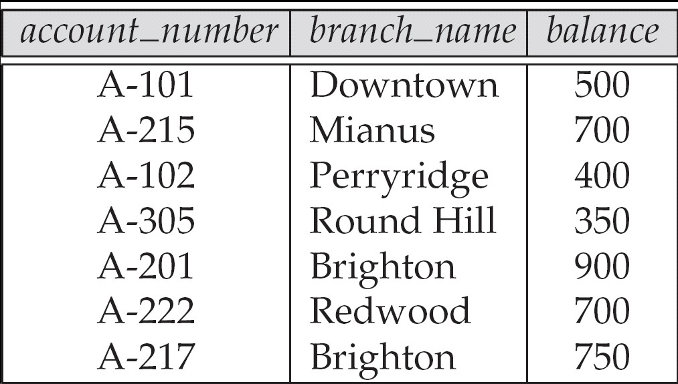
Relations are Unordered
Order of tuples is irrelevant (tuples may be stored in an arbitrary order)
Example: account relation with unordered tuples
Database System Concepts - 5th Edition, June 15, 2005
2.<number>
©Silberschatz, Korth and Sudarshan

Slide 9
Database
■
A database consists of multiple relations
■
Information about an enterprise is broken up into parts, with each relation
storing one part of the information
account :
stores information about accounts
depositor :
stores information about which customer
owns which account
customer : stores information about customers Storing all information as a single relation such as
■
bank(account_number, balance, customer_name, ..) results in
●
repetition of information

e.g.,if two customers own an account (What gets repeated?)
●
the need for null values

e.g., to represent a customer without an account
■
Normalization theory (Chapter 7) deals with how to design relational schemas
Database System Concepts - 5th Edition, June 15, 2005
2.<number>
©Silberschatz, Korth and Sudarshan

Slide 10
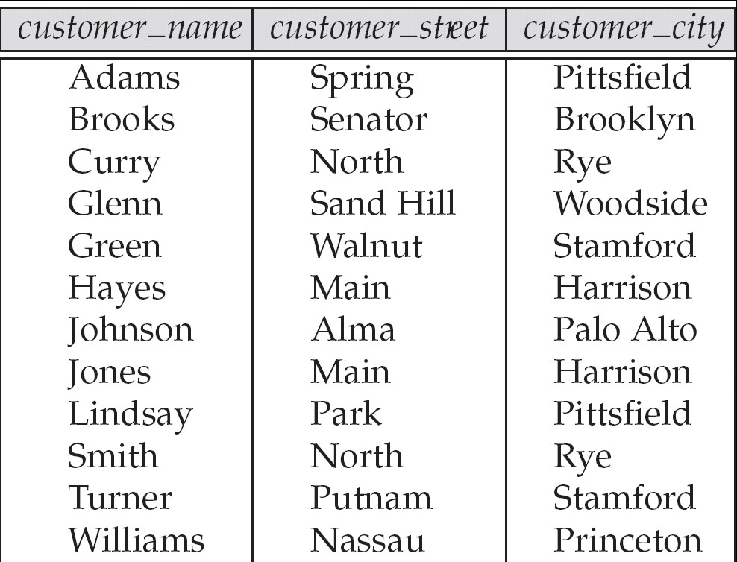
The customer Relation
Database System Concepts - 5th Edition, June 15, 2005
2.<number>
©Silberschatz, Korth and Sudarshan

Slide 11
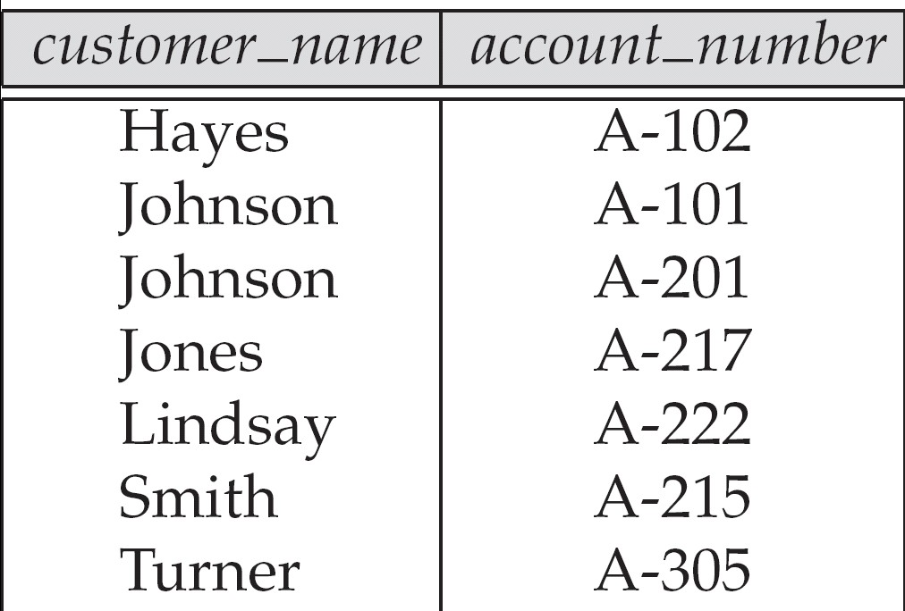
The depositor Relation
Database System Concepts - 5th Edition, June 15, 2005
2.<number>
©Silberschatz, Korth and Sudarshan

Slide 12
Keys
■
Let K ⊆ R
■
K is a superkey of R if values for K are sufficient to identify a unique tuple of
each possible relation r(R)
●
by “possible r ” we mean a relation r that could exist in the enterprise we
are modeling.
●
Example: {customer_name, customer_street} and
{customer_name}
are both superkeys of Customer, if no two customers can possibly have the same name
 In real life, an attribute such as customer_id would be used instead of customer_name to uniquely identify customers, but we omit it to keep our examples small, and instead assume customer names are unique.
Database System Concepts - 5th Edition, June 15, 2005
2.<number>
©Silberschatz, Korth and Sudarshan

Slide 13
Keys (Cont.)
■
K is a candidate key if K is minimal
Example: {customer_name} is a candidate key for Customer, since it is a superkey and no subset of it is a superkey.
■
Primary key: a candidate key chosen as the principal means of
identifying tuples within a relation
●
Should choose an attribute whose value never, or very rarely,
changes.
●
E.g. email address is unique, but may change
Database System Concepts - 5th Edition, June 15, 2005
2.<number>
©Silberschatz, Korth and Sudarshan

Slide 14
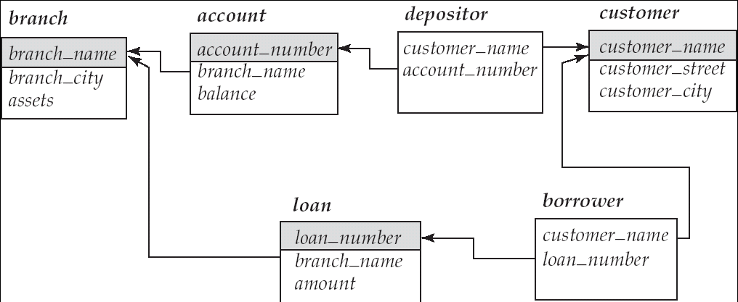
Foreign Keys
■
A relation schema may have an attribute that corresponds to the primary
key of another relation. The attribute is called a foreign key.
●
E.g. customer_name and account_number attributes of depositor are
foreign keys to customer and account respectively.
●
Only values occurring in the primary key attribute of the referenced
relation may occur in the foreign key attribute of the referencing relation.
■
Schema diagram
Database System Concepts - 5th Edition, June 15, 2005
2.<number>
©Silberschatz, Korth and Sudarshan

Slide 15
Query Languages
■
Language in which user requests information from the database.
■
Categories of languages
●
Procedural
●
Non-procedural, or declarative
■
“Pure” languages:
●
Relational algebra
●
Tuple relational calculus
●
Domain relational calculus
■
Pure languages form underlying basis of query languages that people
use.
Database System Concepts - 5th Edition, June 15, 2005
2.<number>
©Silberschatz, Korth and Sudarshan

Slide 16
Relational Algebra
■
Procedural language
■
Six basic operators
●
select: σ
●
project: ∏
●
union: ∪
●
set difference: –
●
Cartesian product: x
●
rename: ρ
■
The operators take one or two relations as inputs and produce a new
relation as a result.
Database System Concepts - 5th Edition, June 15, 2005
2.<number>
©Silberschatz, Korth and Sudarshan

Slide 17
Select Operation – Example
■
Relation r
A | B | C | D
α | α | 1 | 7
α | β | 5 | 7
β | β | 12 | 3
β | β | 23 | 10
^{○σ}A=B ^ D > 5 ^{(r)}
A B C D
α β | α β | 1 23 | 7 10
Database System Concepts - 5th Edition, June 15, 2005
2.<number>
©Silberschatz, Korth and Sudarshan

Slide 18
Select Operation
Notation: σ _{p}(r)
■
p is called the selection predicate
■
Defined as:
σ_{p}(r) = {t | t ∈ r and p(t)}
Where p is a formula in propositional calculus consisting of terms
connected by : ∧ (and), ∨ (or), ¬ (not) Each term is one of:
<attribute> op
where op is one of: =, ≠, >, ≥. <. ≤
<attribute> or <constant>
■
Example of selection:
branch_name=“Perryridge”^{(account)}
Database System Concepts - 5th Edition, June 15, 2005
2.<number>
©Silberschatz, Korth and Sudarshan

Slide 19
Project Operation – Example
A | B | C
■
Relation r:
α | 10 | 1
α | 20 | 1
β | 30 | 1
β | 40 | 2
∏_{A,C} (r)
A C
A C
α 1
α 1
β 1
β 2
α 1
β 1
β 2
=
Database System Concepts - 5th Edition, June 15, 2005
2.<number>
©Silberschatz, Korth and Sudarshan

Slide 20
Project Operation
■
Notation:
∏ (r )
A₁,A₂ ,😐,A_{k}
where A₁, A₂ are attribute names and r is a relation name.
■
The result is defined as the relation of k columns obtained by erasing
the columns that are not listed
■
Duplicate rows removed from result, since relations are sets
■
Example: To eliminate the branch_name attribute of account
∏account_number, balance ^{(account)}
Database System Concepts - 5th Edition, June 15, 2005
2.<number>
©Silberschatz, Korth and Sudarshan

Slide 21
Union Operation – Example
■
Relations r, s:
A B
A B
α 1
α 2
β 1
α 2
β 3
s
r
A B
■
r ∪ s:
α 1
α 2
β 1
β 3
Database System Concepts - 5th Edition, June 15, 2005
2.<number>
©Silberschatz, Korth and Sudarshan

Slide 22
Union Operation
■
Notation: r ∪ s
■
Defined as:
r ∪ s = {t | t ∈ r or t ∈ s}
■
For r ∪ s to be valid.
r, s must have the same arity (same number of attributes)
The attribute domains must be compatible (example: 2nd column of r deals with the same type of values as does the 2nd
column of s)
■
Example: to find all customers with either an account or a loan
∏customer_name ^{(depositor) ∪ ∏}customer_name ^{(borrower)}
Database System Concepts - 5th Edition, June 15, 2005
2.<number>
©Silberschatz, Korth and Sudarshan

Slide 23
Set Difference Operation – Example
■
Relations r, s:
A B
A B
α 1
α 2
β 1
α 2
β 3
s
r
■
r – s:
A B
α 1
β 1
Database System Concepts - 5th Edition, June 15, 2005
2.<number>
©Silberschatz, Korth and Sudarshan

Slide 24
Set Difference Operation
■
Notation r – s
■
Defined as:
r – s = {t | t ∈ r and t ∉ s}
■
Set differences must be taken between compatible
relations.
●
r and s must have the same arity
●
attribute domains of r and s must be compatible
Database System Concepts - 5th Edition, June 15, 2005
2.<number>
©Silberschatz, Korth and Sudarshan

Slide 25
Cartesian-Product Operation – Example
■
Relations r, s:
A B
C D E
α 1
α 10 a
β 10 a
β 20 b
γ 10 b
β 2
r
■
s
r x s:
A | B | C | D | E
α 1 α 10 a
α 1 β 10 a
α 1 β 20 b
α 1 γ 10 b
β 2 α 10 a
β 2 β 10 a
β 2 β 20 b
β 2 γ 10 b
Database System Concepts - 5th Edition, June 15, 2005
2.<number>
©Silberschatz, Korth and Sudarshan

Slide 26
Cartesian-Product Operation
■
Notation r x s
■
Defined as:
r x s = {t q | t ∈ r and q ∈ s}
■
Assume that attributes of r(R) and s(S) are disjoint. (That is, R ∩ S = ∅).
■
If attributes of r(R) and s(S) are not disjoint, then renaming must be
used.
Database System Concepts - 5th Edition, June 15, 2005
2.<number>
©Silberschatz, Korth and Sudarshan

Slide 27
Composition of Operations
■
Can build expressions using multiple operations
■
Example: σ_{A=C}(r x s)
r x s
 | α | 1 | α | 10 | a
 | α | 1 | β | 10 | a
 | α | 1 | β | 20 | b
 | α | 1 | γ | 10 | b
 | β | 2 | α | 10 | a
 | β | 2 | β | 10 | a
 | β | 2 | β | 20 | b
 | β | 2 | γ | 10 | b
σ_{A=C}(r x s)
 | A | B | C | D | E
 | α | 1 | α | 10 | a
 | β | 2 | β | 10 | a
β ₂ |  |  | β | 20 | b
A | B | C | D | E
Database System Concepts - 5th Edition, June 15, 2005
2.<number>
©Silberschatz, Korth and Sudarshan

Slide 28
Rename Operation
■
Allows us to name, and therefore to refer to, the results of relational-
algebra expressions.
■
Allows us to refer to a relation by more than one name.
■
Example:
ρ _{x} (E)
returns the expression E under the name X
■
If a relational-algebra expression E has arity n, then
^{ρ}x ( A ,A ,...,A
1 2 n
₎ (E )
returns the result of expression E under the name X, and with the attributes renamed to A₁ , A₂ , …., A_{n} .
Database System Concepts - 5th Edition, June 15, 2005
2.<number>
©Silberschatz, Korth and Sudarshan

Slide 29
Banking Example
branch (branch_name, branch_city, assets)
customer (customer_name, customer_street, customer_city)
account (account_number, branch_name, balance) loan (loan_number, branch_name, amount) depositor (customer_name, account_number) borrower (customer_name, loan_number)
Database System Concepts - 5th Edition, June 15, 2005
2.<number>
©Silberschatz, Korth and Sudarshan

Slide 30
Example Queries
■
Find all loans of over $1200
σ_{amount > 1200} (loan)
■
Find the loan number for each loan of an amount greater than
$1200
∏loan_number ^{(σ}amount ^{> 1200 (loan))}
■
Find the names of all customers who have a loan, an account, or both,
from the bank
∏customer_name ^{(borrower) ∪ ∏}customer_name ^{(depositor)}
Database System Concepts - 5th Edition, June 15, 2005
2.<number>
©Silberschatz, Korth and Sudarshan

Slide 31
Example Queries
■
Find the names of all customers who have a loan at the Perryridge
branch.
∏customer_name ^{(σ}branch_name=“Perryridge^{” (σ}borrower.loan_number = loan.loan_number^{(borrower x loan)))}
■
Find the names of all customers who have a loan at the
Perryridge branch but do not have an account at any branch of the bank.
∏customer_name ^{(σ}branch_name = “Perryridge”
^{(σ}borrower.loan_number = loan.loan_number^{(borrower x loan))) –}
∏customer_name^{(depositor)}
Database System Concepts - 5th Edition, June 15, 2005
2.<number>
©Silberschatz, Korth and Sudarshan

Slide 32
Example Queries
■
Find the names of all customers who have a loan at the Perryridge branch.
●
Query 1
∏customer_name ^{(σ}branch_name = “Perryridge” ⁽
^{σ}borrower.loan_number = loan.loan_number ^{(borrower x loan)))}
●
Query 2
∏customer_name^{(σ}loan.loan_number = borrower.loan_number ^{( (σ}branch_name = “Perryridge^{” (loan)) x borrower))}
Database System Concepts - 5th Edition, June 15, 2005
2.<number>
©Silberschatz, Korth and Sudarshan

Slide 33
Example Queries
■
Find the largest account balance
●
Strategy:

Find those balances that are not the largest
– Rename account relation as d so that we can compare each account balance with all others

Use set difference to find those account balances that were not found
in the earlier step.
●
The query is:
∏balance^{(account) - ∏}account.balance
^{(σ}account.balance < d.balance ^{(account x ρ}d ^{(account)))}
Database System Concepts - 5th Edition, June 15, 2005
2.<number>
©Silberschatz, Korth and Sudarshan

Slide 34
Formal Definition
■
A basic expression in the relational algebra consists of either one of the
following:
●
A relation in the database
●
A constant relation
Let E₁ and E₂ be relational-algebra expressions; the following are all relational-algebra expressions:
●
E₁ ∪ E₂
●
E₁ – E₂
●
E₁ x E₂
●
σ_{p} (E₁), P is a predicate on attributes in E₁
●
∏_{s}(E₁), S is a list consisting of some of the attributes in E₁
●
ρ (E ), x is the new name for the result of E
Database System Concepts -x5th Edi1tion, June 15, 2005
2.<number>
1
©Silberschatz, Korth and Sudarshan

Slide 35
Additional Operations
We define additional operations that do not add any power to the relational algebra, but that simplify common queries.
■
Set intersection
■
Natural join
■
Division
■
Assignment
Database System Concepts - 5th Edition, June 15, 2005
2.<number>
©Silberschatz, Korth and Sudarshan

Slide 36
Set-Intersection Operation
■
Notation: r ∩ s
■
Defined as:
■
r ∩ s = { t | t ∈ r and t ∈ s }
■
Assume:
●
r, s have the same arity
●
attributes of r and s are compatible
■
Note: r ∩ s = r – (r – s)
Database System Concepts - 5th Edition, June 15, 2005
2.<number>
©Silberschatz, Korth and Sudarshan

Slide 37
Set-Intersection Operation – Example
■
Relation r, s:
A
B
A
B
α
1
α
β
2
3
α
β
2
1
r
s
■
r ∩ s
A
B
α 2
Database System Concepts - 5th Edition, June 15, 2005
2.<number>
©Silberschatz, Korth and Sudarshan

Slide 38
Natural-Join Operation
■
Notation: r s
Let r and s be relations on schemas R and S respectively. Then, r s is a relation on schema R ∪ S obtained as follows:
■
●
Consider each pair of tuples t_{r} from r and t_{s} from s.
●
If t_{r} and t_{s} have the same value on each of the attributes in R ∩ S, add a
tuple t to the result, where
 t has the same value as t on r
r
 t has the same value as t on s
s
■
Example:
R = (A, B, C, D)
S = (E, B, D)
●
Result schema = (A, B, C, D, E) r s is defined as:
●
Database System Concepts - 5th Edition, June 15, 2005
2.<number>
©Silberschatz, Korth and Sudarshan

Slide 39
Natural Join Operation – Example
■
Relations r, s:
A B C D
B D E
α 1 α a
1 a α
3 a β
a γ
b δ
b ∈
β 2 γ a
γ 4 β b
α 1 γ a
δ 2 β b
r
s
■
r s
A B C D E
α α α α δ | 1 1 1 1 2 | α α γ γ β | a a a a b | α γ α γ δ
Database System Concepts - 5th Edition, June 15, 2005
2.<number>
©Silberschatz, Korth and Sudarshan

Slide 40
Division Operation
■
Notation:
r ÷ s
■
Suited to queries that include the phrase “for all”.
■
Let r and s be relations on schemas R and S respectively
where
●
R = (A₁, …, A_{m} , B₁, …, B_{n} )
● S = (B₁, …, B_{n})
The result of r ÷ s is a relation on schema
R – S = (A₁, …, A_{m})
r ÷ s = { t | t ∈ ∏ _{R-S} (r) ∧ ∀ u ∈ s ( tu ∈ r ) }
Where tu means the concatenation of tuples t and u to produce a single tuple
Database System Concepts - 5th Edition, June 15, 2005
2.<number>
©Silberschatz, Korth and Sudarshan

Slide 41
Division Operation – Example
■
Relations r, s:
A B
B
α 1
1
2
α 2
α 3
β 1
γ 1
δ 1
δ 3
δ 4
∈ 6
∈ 1
β 2
s
■
r ÷ s:
A
r
α
β
Database System Concepts - 5th Edition, June 15, 2005
2.<number>
©Silberschatz, Korth and Sudarshan

Slide 42
Another Division Example
Relations r, s:
 | A | B | C | D | E | D
 | α | a | α | a | 1 | a
 | α | a | γ | a | 1 | b
 | α | a | γ | b | 1
 | β | a | γ | a | 1
 | β | a | γ | b | 3
 | γ | a | γ | a | 1
 | γ | a | γ | b | 1
 | γ | a | β | b | 1
 |  |  | r
r ÷ s: |  |  | A | B | C
E 1
1
s
α γ | a a | γ γ
Database System Concepts - 5th Edition, June 15, 2005
2.<number>
©Silberschatz, Korth and Sudarshan

Slide 43
Division Operation (Cont.)
■
Property
●
Let q = r ÷ s
●
Then q is the largest relation satisfying q x s ⊆ r
■
Definition in terms of the basic algebra operation
Let r(R) and s(S) be relations, and let S ⊆ R
r ÷ s = ∏_{R-S} (r ) – ∏_{R-S} ( ( ∏_{R-S} (r ) x s ) – ∏_{R-S,S}(r )) To see why
●
∏_{R-S,S} (r) simply reorders attributes of r
●
∏_{R-S} (∏_{R-S} (r ) x s ) – ∏_{R-S,S}(r) ) gives those tuples t in
∏_{R-S} (r ) such that for some tuple u ∈ s, tu ∉ r.
Database System Concepts - 5th Edition, June 15, 2005
2.<number>
©Silberschatz, Korth and Sudarshan

Slide 44
Assignment Operation
■
The assignment operation (←) provides a convenient way to express
complex queries.
●
Write query as a sequential program consisting of

a series of assignments

followed by an expression whose value is displayed as a result of
the query.
●
Assignment must always be made to a temporary relation variable.
■
Example: Write r ÷ s as
temp1 ← ∏_{R-S} (r )
temp2 ← ∏_{R-S} ((temp1 x s ) – ∏_{R-S,S} (r ))
result = temp1 – temp2
●
The result to the right of the ← is assigned to the relation variable on
the left of the ←.
●
May use variable in subsequent expressions.
Database System Concepts - 5th Edition, June 15, 2005
2.<number>
©Silberschatz, Korth and Sudarshan

Slide 45
Bank Example Queries
■
Find the names of all customers who have a loan and an account at
bank.
∏customer_name ^{(borrower) ∩ ∏}customer_name ^{(depositor)}
■
Find the name of all customers who have a loan at the bank and the
loan amount
∏customer_name, loan_number, amount ^{(borrower}
loan)
Database System Concepts - 5th Edition, June 15, 2005
2.<number>
©Silberschatz, Korth and Sudarshan

Slide 46
Bank Example Queries
■
Find all customers who have an account from at least the “Downtown”
and the Uptown” branches.
Query 1
∏customer_name ^{(σ}branch_name = “Downtown^{” (depositor}
account )) ∩
∏customer_name ^{(σ}branch_name = “Uptown^{” (depositor}
account))
●
Query 2
∏customer_name, branch_name ^{(depositor}
account)
÷ ρ_{temp(branch_name)} ({(“Downtown” ), (“Uptown” )}) Note that Query 2 uses a constant relation.
Database System Concepts - 5th Edition, June 15, 2005
2.<number>
©Silberschatz, Korth and Sudarshan

Slide 47
Bank Example Queries
■
Find all customers who have an account at all branches located in
Brooklyn city.
∏customer_name, branch_name ^{(depositor}
account)
÷ ∏branch_name ^{(σ}branch_city = “Brooklyn” ^{(branch))}
Database System Concepts - 5th Edition, June 15, 2005
2.<number>
©Silberschatz, Korth and Sudarshan

Slide 48
Extended Relational-Algebra-Operations
■
Generalized Projection
■
Aggregate Functions
■
Outer Join
Database System Concepts - 5th Edition, June 15, 2005
2.<number>
©Silberschatz, Korth and Sudarshan

Slide 49
Generalized Projection
■
Extends the projection operation by allowing arithmetic functions to be
used in the projection list.
∏ _{F} ,_{F} ,..., _{F} (E)
1 2 n
E is any relational-algebra expression
■
Each of F₁, F₂, …, F_{n} are are arithmetic expressions involving constants and attributes in the schema of E.
■
Given relation credit_info(customer_name, limit, credit_balance), find
how much more each person can spend:
∏customer_name, limit – credit_balance ^{(credit_info)}
Database System Concepts - 5th Edition, June 15, 2005
2.<number>
©Silberschatz, Korth and Sudarshan

Slide 50
Aggregate Functions and Operations
■
Aggregation function takes a collection of values and returns a single
value as a result.
avg: average value min: minimum value max: maximum value sum: sum of values
count: number of values
■
Aggregate operation in relational algebra
G ,G ,😐,G ^{ϑ}F ( A ),F ( A ,😐,F ( A
1 2 n 1 1 2 2 n n
₎ (E )
E is any relational-algebra expression
●
G₁, G₂ …, G_{n} is a list of attributes on which to group (can be empty)
●
Each F_{i} is an aggregate function
●
Each A_{i} is an attribute name
Database System Concepts - 5th Edition, June 15, 2005
2.<number>
©Silberschatz, Korth and Sudarshan

Slide 51
Aggregate Operation – Example
■
Relation r:
A | B | C
α α 7
α β 7
β β 3
β β 10
■
^{g} sum(c^{) (r)}
sum(c )
27
Database System Concepts - 5th Edition, June 15, 2005
2.<number>
©Silberschatz, Korth and Sudarshan

Slide 52
Aggregate Operation – Example
■
Relation account grouped by branch-name:
branch_name account_number
balance
Perryridge | A-102 | 400
Perryridge | A-201 | 900
Brighton | A-217 | 750
Brighton | A-215 | 750
Redwood | A-222 | 700
branch_name ^{g} sum(balance) ^{(account)}
branch_name
sum(balance)
Perryridge
1300
Brighton Redwood
1500
700
Database System Concepts - 5th Edition, June 15, 2005
2.<number>
©Silberschatz, Korth and Sudarshan

Slide 53
Aggregate Functions (Cont.)
■
Result of aggregation does not have a name
●
Can use rename operation to give it a name
●
For convenience, we permit renaming as part of aggregate
operation
branch_name ^{g} sum(balance) as sum_balance ^{(account)}
Database System Concepts - 5th Edition, June 15, 2005
2.<number>
©Silberschatz, Korth and Sudarshan

Slide 54
Outer Join
■
An extension of the join operation that avoids loss of information.
■
Computes the join and then adds tuples form one relation that does not
match tuples in the other relation to the result of the join.
■
Uses null values:
●
null signifies that the value is unknown or does not exist
●
All comparisons involving null are (roughly speaking) false by
definition.
 We shall study precise meaning of comparisons with nulls later
Database System Concepts - 5th Edition, June 15, 2005
2.<number>
©Silberschatz, Korth and Sudarshan

Slide 55
Outer Join – Example
■
Relation loan
loan_number | branch_name | amount
L-170 | Downtown | 3000
L-230 | Redwood | 4000
L-260 | Perryridge | 1700
■
Relation borrower
customer_name
loan_number
Jones
L-170
Smith Hayes
L-230 L-155
Database System Concepts - 5th Edition, June 15, 2005
2.<number>
©Silberschatz, Korth and Sudarshan

Slide 56
Outer Join – Example
■
Join
loan
borrower
loan_number | branch_name | amount | customer_name
L-170 L-230 | Downtown Redwood | 3000 4000 | Jones Smith
Left Outer Join
loan
borrower
loan_number | branch_name | amount | customer_name
L-170 | Downtown | 3000 | Jones
L-230 | Redwood | 4000 | Smith
L-260 | Perryridge | 1700 | null
Database System Concepts - 5th Edition, June 15, 2005
2.<number>
©Silberschatz, Korth and Sudarshan

Slide 57
Outer Join – Example
Right Outer Join
loan borrower
loan_number
branch_name
amount
customer_name
L-170
Downtown
3000
Jones
L-230
Redwood
4000
Smith
L-155
null
null
Hayes
Full Outer Join
loan borrower
loan_number | branch_name | amount | customer_name
L-170 | Downtown | 3000 | Jones
L-230 | Redwood | 4000 | Smith
L-260 | Perryridge | 1700 | null
L-155 | null | null | Hayes
Database System Concepts - 5th Edition, June 15, 2005
2.<number>
©Silberschatz, Korth and Sudarshan

Slide 58
Null Values
■
It is possible for tuples to have a null value, denoted by null, for some
of their attributes
■
null signifies an unknown value or that a value does not exist.
■
The result of any arithmetic expression involving null is null.
■
Aggregate functions simply ignore null values (as in SQL)
■
For duplicate elimination and grouping, null is treated like any other
value, and two nulls are assumed to be the same (as in SQL)
Database System Concepts - 5th Edition, June 15, 2005
2.<number>
©Silberschatz, Korth and Sudarshan

Slide 59
Null Values
■
Comparisons with null values return the special truth value: unknown
●
If false was used instead of unknown, then not (A < 5)
would not be equivalent to A >= 5
Three-valued logic using the truth value unknown:
■
●
OR: (unknown or true) = true,
(unknown or false) = unknown
(unknown or unknown) = unknown
●
AND: (true and unknown) = unknown,
(false and unknown) = false,
(unknown and unknown) = unknown
●
NOT: (not unknown) = unknown
●
In SQL “P is unknown” evaluates to true if predicate P evaluates to
unknown
■
Result of select predicate is treated as false if it evaluates to unknown
Database System Concepts - 5th Edition, June 15, 2005
2.<number>
©Silberschatz, Korth and Sudarshan

Slide 60
Modification of the Database
■
The content of the database may be modified using the following
operations:
●
Deletion
●
Insertion
●
Updating
■
All these operations are expressed using the assignment
operator.
Database System Concepts - 5th Edition, June 15, 2005
2.<number>
©Silberschatz, Korth and Sudarshan

Slide 61
Deletion
■
A delete request is expressed similarly to a query, except
instead of displaying tuples to the user, the selected tuples are removed from the database.
■
Can delete only whole tuples; cannot delete values on only
particular attributes
■
A deletion is expressed in relational algebra by:
r ← r – E
where r is a relation and E is a relational algebra query.
Database System Concepts - 5th Edition, June 15, 2005
2.<number>
©Silberschatz, Korth and Sudarshan

Slide 62
Deletion Examples
■
Delete all account records in the Perryridge branch.
account ← account – σ _{branch_name = “Perryridge”} (account )
■
Delete all loan records with amount in the range of 0 to 50
^{loan ← loan – σ} amount ≥ 0 and amount ≤ 50 ^{(loan)}
■
Delete all accounts at branches located in Needham.
^{r1 ← σ}branch_city = “Needham” ^{(account}
branch )
^{r2 ← ∏} account_number, branch_name, balance ^{(r1)}
^{r3 ← ∏} customer_name, account_number ^{(r2}
depositor)
account ← account – r₂ depositor ← depositor – r₃
Database System Concepts - 5th Edition, June 15, 2005
2.<number>
©Silberschatz, Korth and Sudarshan

Slide 63
Insertion
■
To insert data into a relation, we either:
●
specify a tuple to be inserted
●
write a query whose result is a set of tuples to be inserted
■
in relational algebra, an insertion is expressed by:
r ← r ∪ E
where r is a relation and E is a relational algebra expression.
■
The insertion of a single tuple is expressed by letting E be a constant
relation containing one tuple.
Database System Concepts - 5th Edition, June 15, 2005
2.<number>
©Silberschatz, Korth and Sudarshan

Slide 64
Insertion Examples
■
Insert information in the database specifying that Smith has $1200 in
account A-973 at the Perryridge branch.
account ← account ∪ {(“A-973”, “Perryridge”, 1200)} depositor ← depositor ∪ {(“Smith”, “A-973”)}
■
Provide as a gift for all loan customers in the Perryridge
branch, a $200 savings account. Let the loan number serve as the account number for the new savings account.
^{r}1 ^{← (σ}branch_name = “Perryridge” ^{(borrower}
loan))
^{account ← account ∪ ∏}loan_number, ^{branch_name,} 200 ^{(r}1^{) depositor ← depositor ∪ ∏}customer_name, loan_number ^{(r}1⁾
Database System Concepts - 5th Edition, June 15, 2005
2.<number>
©Silberschatz, Korth and Sudarshan

Slide 65
Updating
■
A mechanism to change a value in a tuple without charging all values in
the tuple
■
Use the generalized projection operator to do this task
r ← ∏
, (r )
F₁,F₂ ,😐,F_{l}
■
Each F_{i} is either
●
the I ^{th} attribute of r, if the I ^{th} attribute is not updated, or,
●
if the attribute is to be updated F_{i} is an expression, involving only
constants and the attributes of r, which gives the new value for the attribute
Database System Concepts - 5th Edition, June 15, 2005
2.<number>
©Silberschatz, Korth and Sudarshan

Slide 66
Update Examples
■
Make interest payments by increasing all balances by 5 percent.
^{account ← ∏} account_number, branch_name, balance * 1.05 ^{(account)}
■
Pay all accounts with balances over $10,000 6 percent interest
and pay all others 5 percent
^{account ← ∏} account_number, branch_name, balance * 1.06 (σ BAL > 10000 (account ))
∪ ∏ account_number, branch_name, balance * 1.05 (σBAL ≤ 10000 (account))
Database System Concepts - 5th Edition, June 15, 2005
2.<number>
©Silberschatz, Korth and Sudarshan

Slide 67
End of Chapter 2
Database System Concepts, 5th Ed.
©Silberschatz, Korth and Sudarshan
See www.db-book.com for conditions on re-use

Slide 68
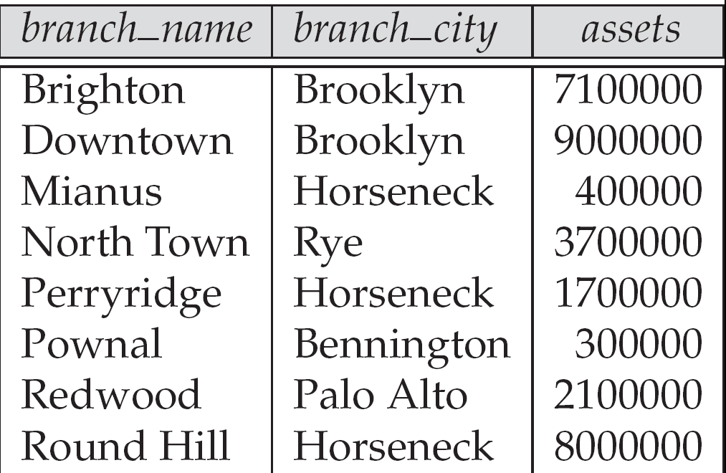
Figure 2.3. The branch relation
Database System Concepts - 5th Edition, June 15, 2005
2.<number>
©Silberschatz, Korth and Sudarshan

Slide 69
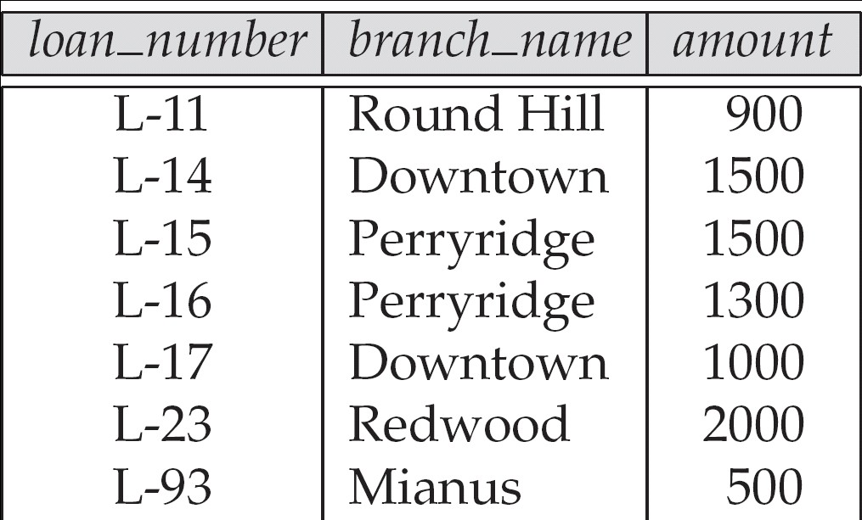
Figure 2.6: The loan relation
Database System Concepts - 5th Edition, June 15, 2005
2.<number>
©Silberschatz, Korth and Sudarshan

Slide 70
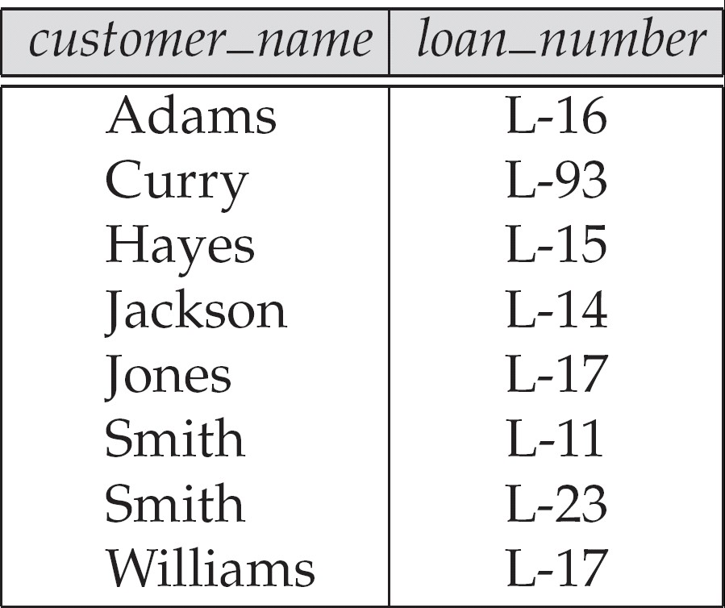
Figure 2.7: The borrower relation
Database System Concepts - 5th Edition, June 15, 2005
2.<number>
©Silberschatz, Korth and Sudarshan

Slide 71
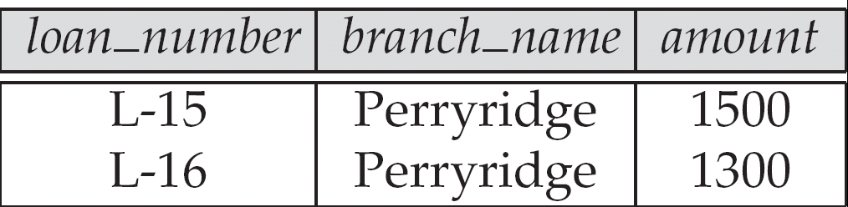
Figure 2.9
^{Result of σ}branch_name = “Perryridge” ^{(loan)}
Database System Concepts - 5th Edition, June 15, 2005
2.<number>
©Silberschatz, Korth and Sudarshan

Slide 72
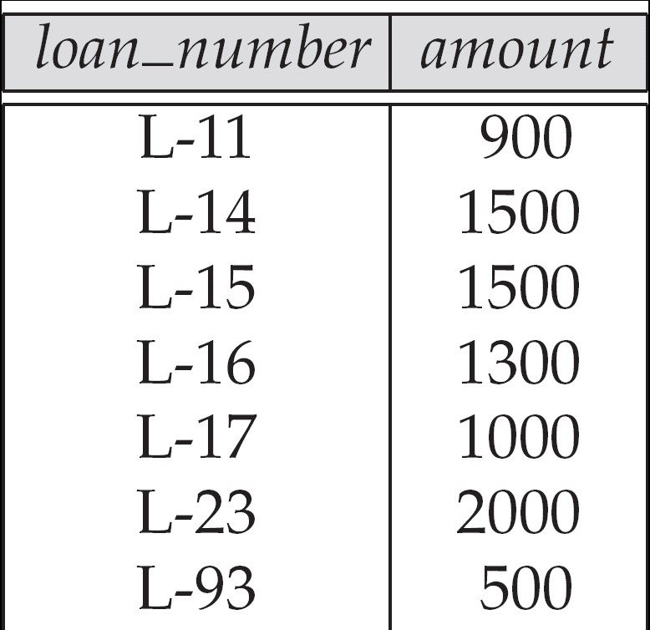
Figure 2.10:
Loan number and the amount of the loan
Database System Concepts - 5th Edition, June 15, 2005
2.<number>
©Silberschatz, Korth and Sudarshan

Slide 73
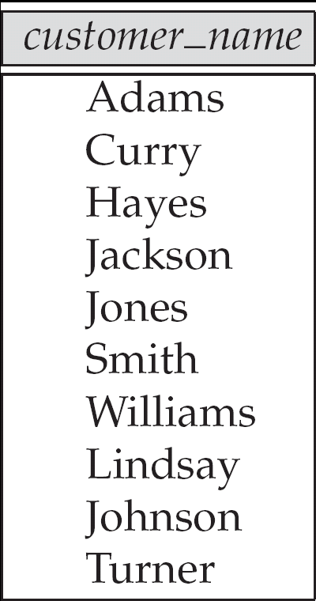
Figure 2.11: Names of all customers who have either an account or an loan
Database System Concepts - 5th Edition, June 15, 2005
2.<number>
©Silberschatz, Korth and Sudarshan

Slide 74
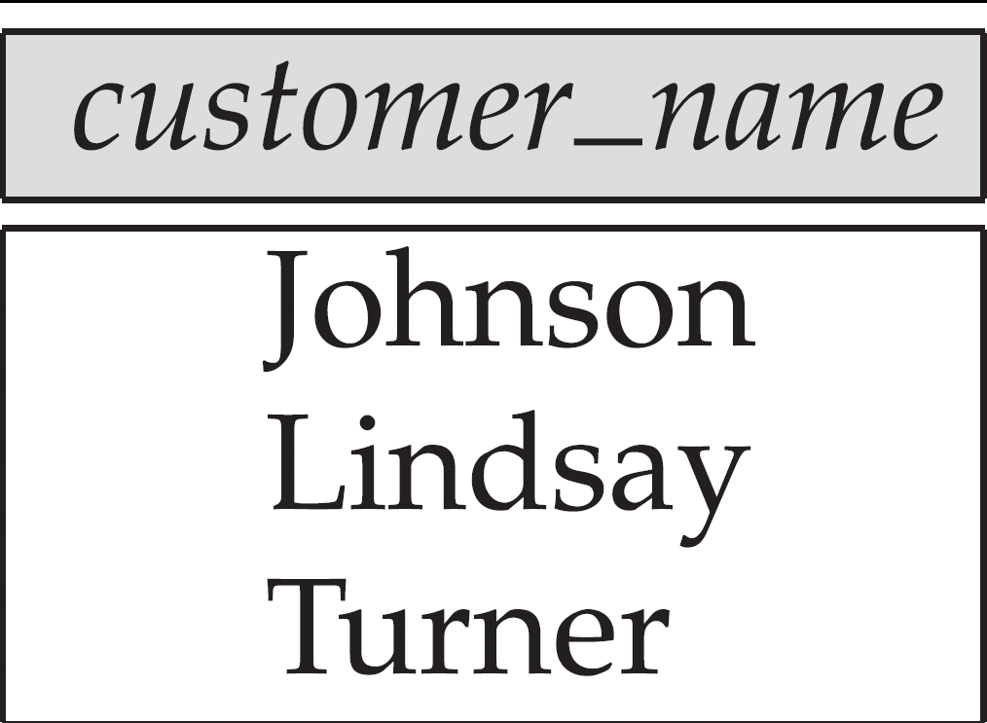
Figure 2.12:
Customers with an account but no loan
Database System Concepts - 5th Edition, June 15, 2005
2.<number>
©Silberschatz, Korth and Sudarshan

Slide 75
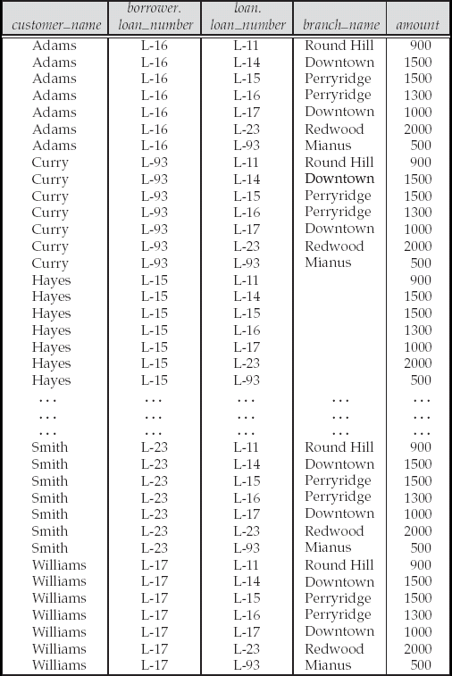
Figure 2.13: Result of borrower |X| loan
Database System Concepts - 5th Edition, June 15, 2005
2.<number>
©Silberschatz, Korth and Sudarshan

Slide 76
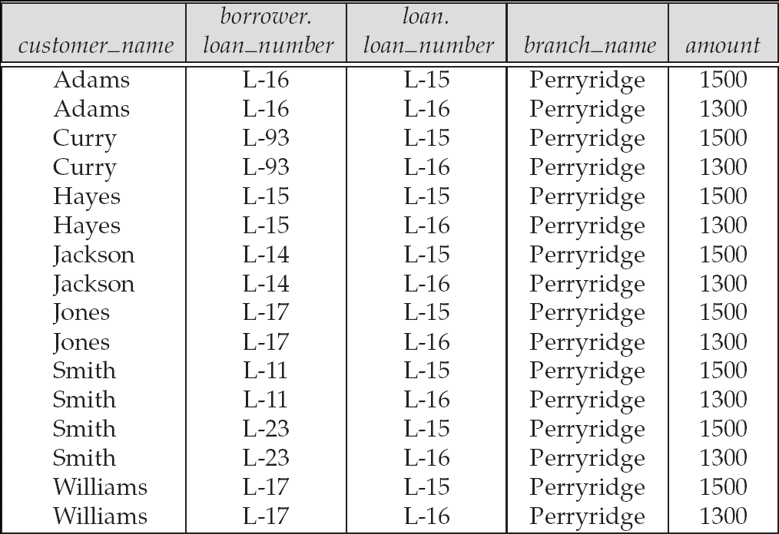
Figure 2.14
Database System Concepts - 5th Edition, June 15, 2005
2.<number>
©Silberschatz, Korth and Sudarshan

Slide 77
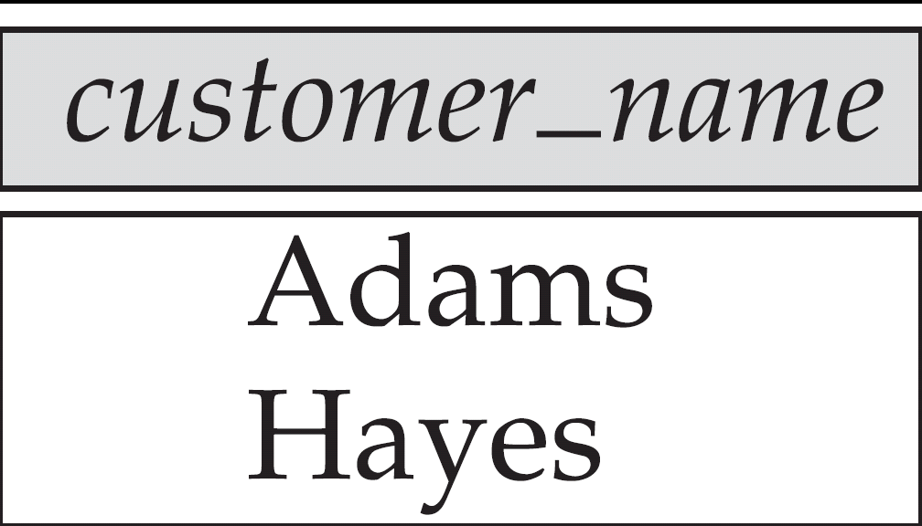
Figure 2.15
Database System Concepts - 5th Edition, June 15, 2005
2.<number>
©Silberschatz, Korth and Sudarshan

Slide 78
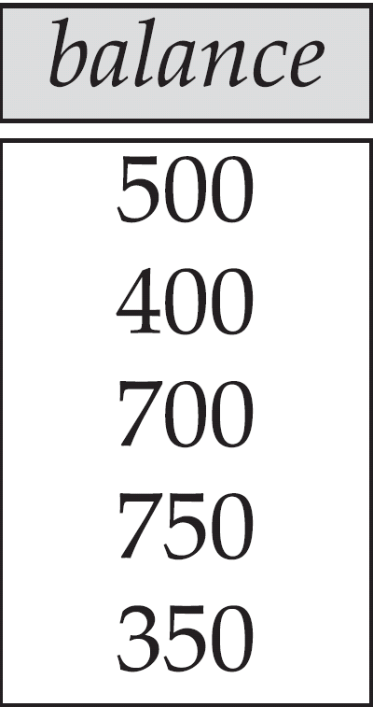
Figure 2.16
Database System Concepts - 5th Edition, June 15, 2005
2.<number>
©Silberschatz, Korth and Sudarshan

Slide 79
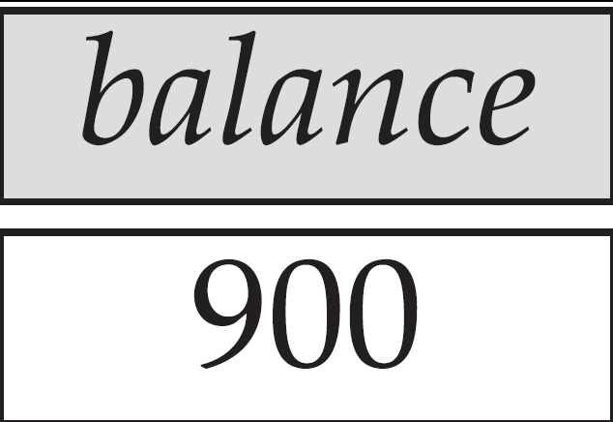
Figure 2.17
Largest account balance in the bank
Database System Concepts - 5th Edition, June 15, 2005
2.<number>
©Silberschatz, Korth and Sudarshan

Slide 80
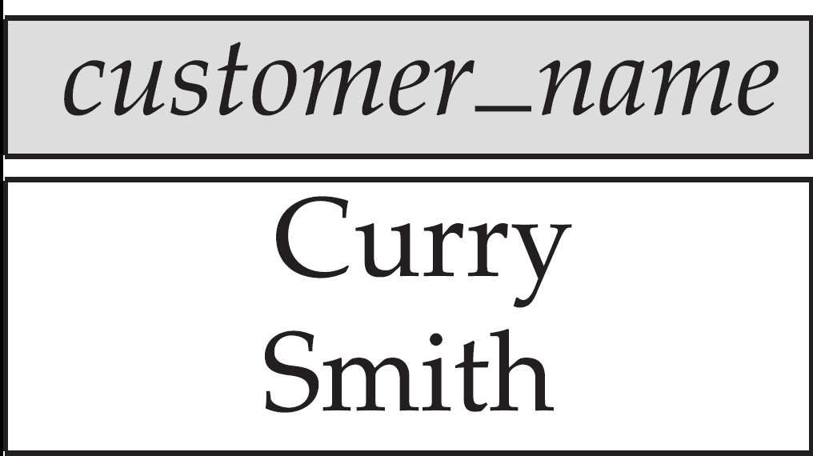
Figure 2.18: Customers who live on the same street and in the same city as Smith
Database System Concepts - 5th Edition, June 15, 2005
2.<number>
©Silberschatz, Korth and Sudarshan

Slide 81
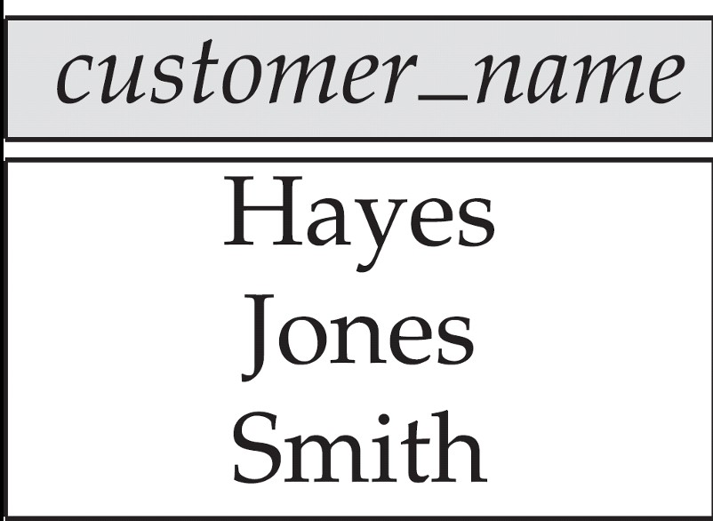
Figure 2.19: Customers with both an account and a loan at the bank
Database System Concepts - 5th Edition, June 15, 2005
2.<number>
©Silberschatz, Korth and Sudarshan

Slide 82
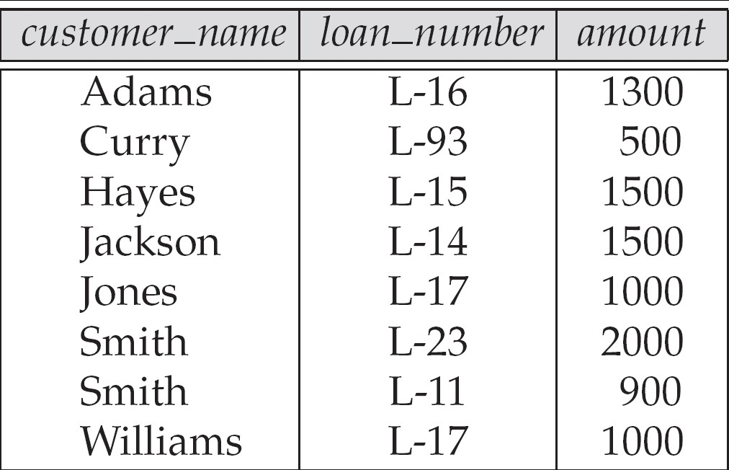
Figure 2.20
Database System Concepts - 5th Edition, June 15, 2005
2.<number>
©Silberschatz, Korth and Sudarshan

Slide 83
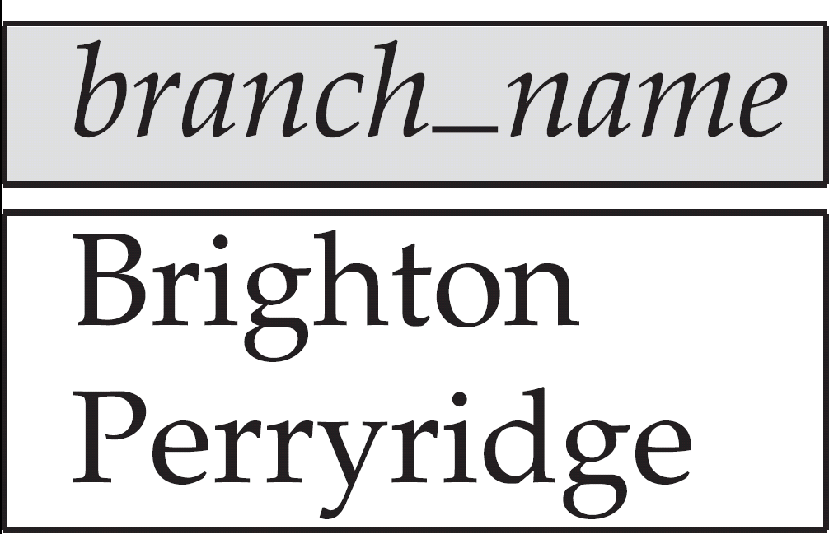
Figure 2.21
Database System Concepts - 5th Edition, June 15, 2005
2.<number>
©Silberschatz, Korth and Sudarshan

Slide 84
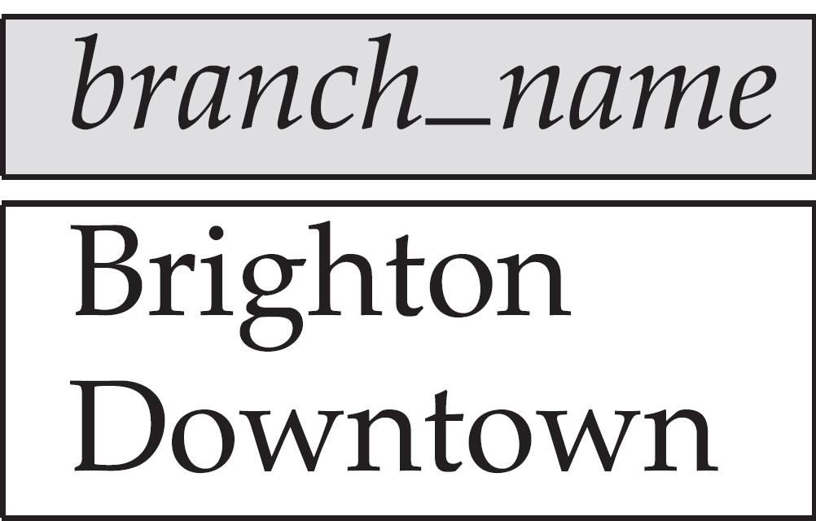
Figure 2.22
Database System Concepts - 5th Edition, June 15, 2005
2.<number>
©Silberschatz, Korth and Sudarshan

Slide 85
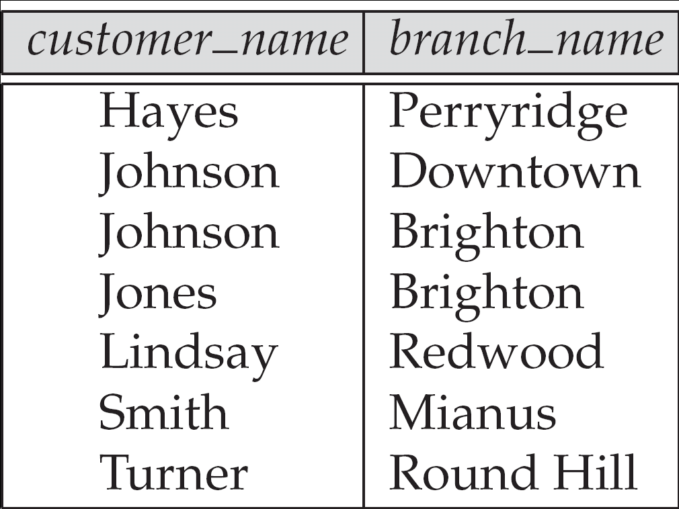
Figure 2.23
Database System Concepts - 5th Edition, June 15, 2005
2.<number>
©Silberschatz, Korth and Sudarshan

Slide 86
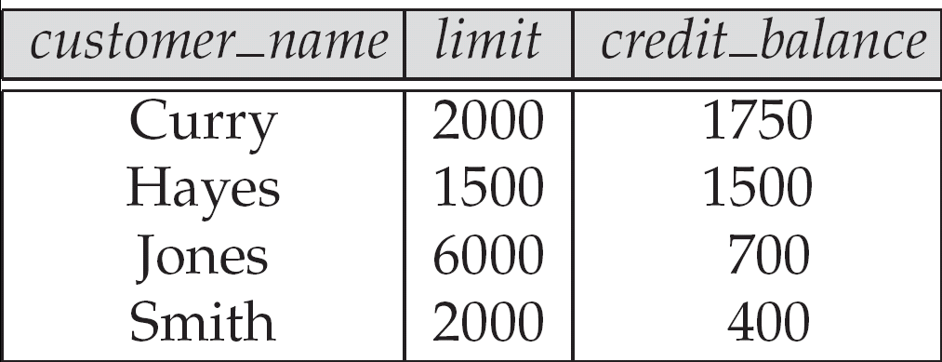
Figure 2.24: The credit_info relation
Database System Concepts - 5th Edition, June 15, 2005
2.<number>
©Silberschatz, Korth and Sudarshan

Slide 87
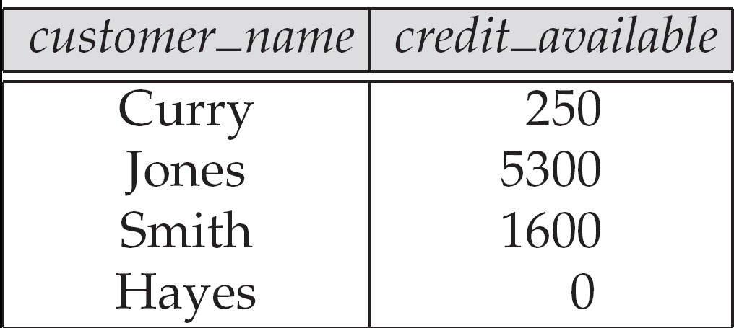
Figure 2.25
Database System Concepts - 5th Edition, June 15, 2005
2.<number>
©Silberschatz, Korth and Sudarshan

Slide 88
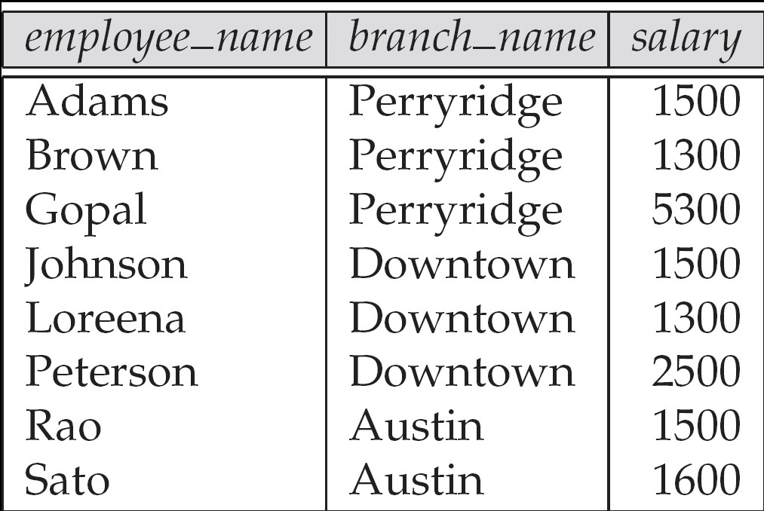
Figure 2.26: The pt_works relation
Database System Concepts - 5th Edition, June 15, 2005
2.<number>
©Silberschatz, Korth and Sudarshan

Slide 89
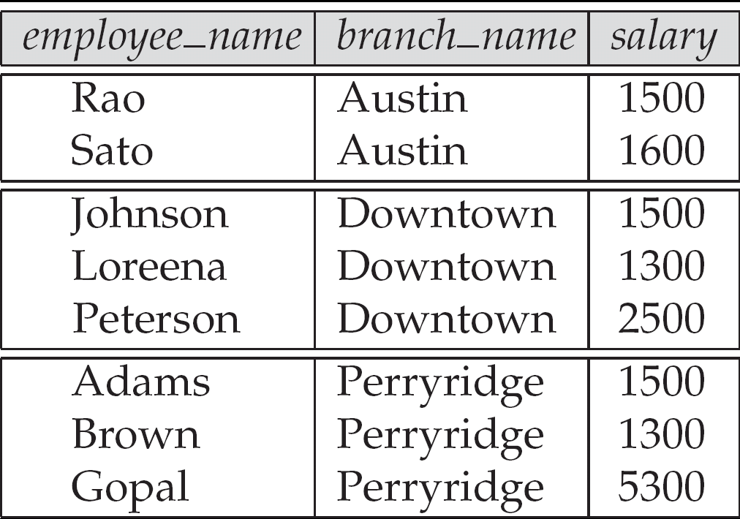
Figure 2.27
The pt_works relation after regrouping
Database System Concepts - 5th Edition, June 15, 2005
2.<number>
©Silberschatz, Korth and Sudarshan

Slide 90
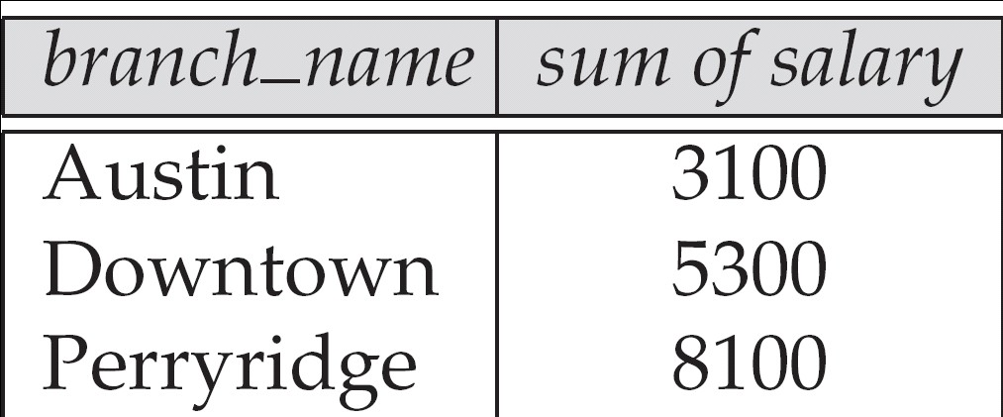
Figure 2.28
Database System Concepts - 5th Edition, June 15, 2005
2.<number>
©Silberschatz, Korth and Sudarshan

Slide 91
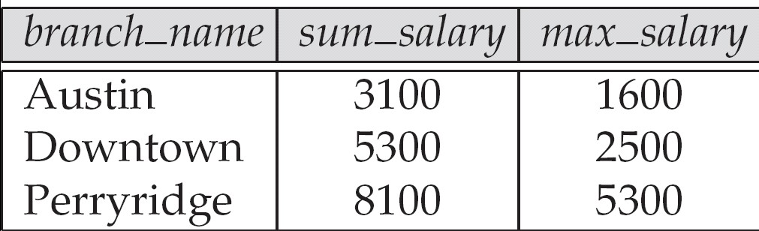
Figure 2.29
Database System Concepts - 5th Edition, June 15, 2005
2.<number>
©Silberschatz, Korth and Sudarshan

Slide 92
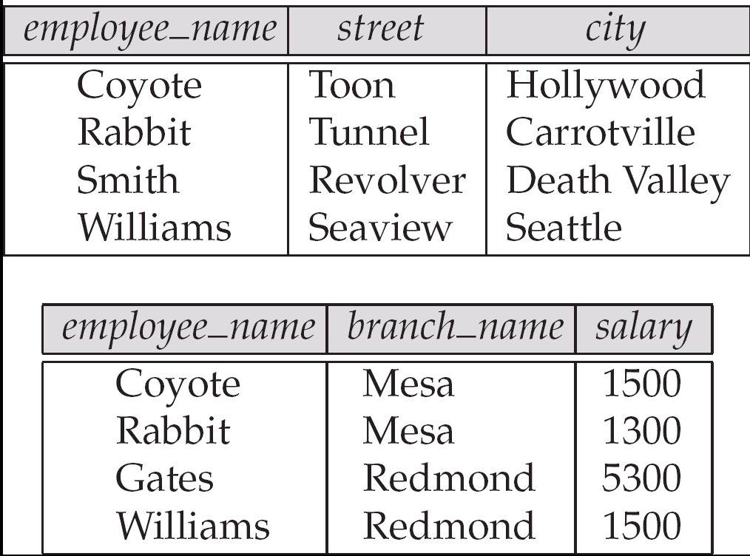
Figure 2.30
The employee and ft_works relations
Database System Concepts - 5th Edition, June 15, 2005
2.<number>
©Silberschatz, Korth and Sudarshan

Slide 93
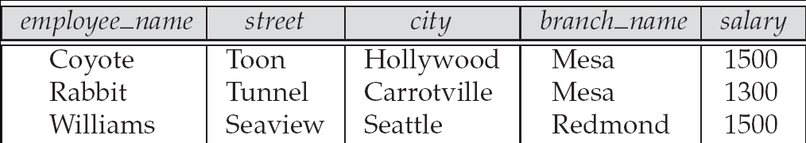
Figure 2.31
Database System Concepts - 5th Edition, June 15, 2005
2.<number>
©Silberschatz, Korth and Sudarshan

Slide 94
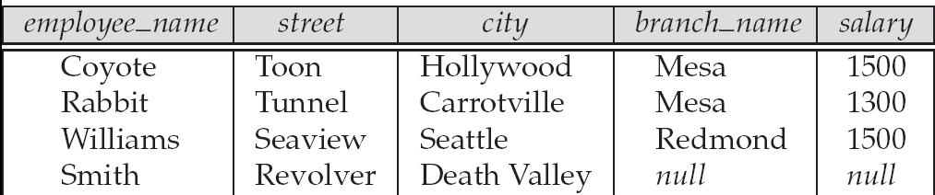
Figure 2.32
Database System Concepts - 5th Edition, June 15, 2005
2.<number>
©Silberschatz, Korth and Sudarshan

Slide 95
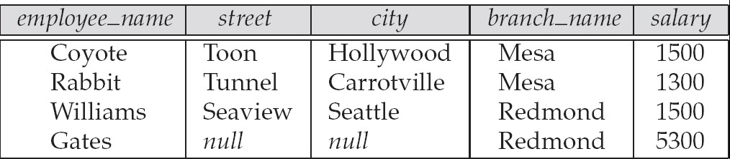
Figure 2.33
Database System Concepts - 5th Edition, June 15, 2005
2.<number>
©Silberschatz, Korth and Sudarshan

Slide 96
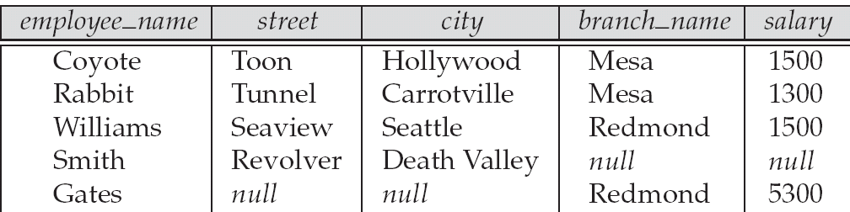
Figure 2.34
Database System Concepts - 5th Edition, June 15, 2005
2.<number>
©Silberschatz, Korth and Sudarshan

